Slide 1
Urban & Rural areas differences

Slide 2
Urban Area
An urban area is a location characterized by high human population density and vast human-built features in comparison to the areas surrounding it. Urban areas may be cities, towns or conurbations, but the term is not commonly extended to rural settlements such as villages and hamlets.

Slide 3
Rural Area
In general, a rural area or countryside' is a geographic area that is located outside cities and the centers of towns.

Slide 4
Urban & Rural Differences
Human settlement areas are classified depending on lot of things, countries, state, rural, urban, etc. The most common way to classify a residential area is according to urban and rural. If a place is considered as urban or rural varies depending on country and nations. However, almost all countries agree that in order for a place to classify as urban, it requires having less space between structures and population level must be high.

Slide 5
Urban Areas Characteristics
Urban areas are characterized by having higher population density and vast human features compared to the surrounding areas. Cities, towns are commonly referred to as urban areas.
It must also have ongoing urbanization for further development. Metropolitan cities, which include satellite cities, are also considered as urban places.
Urban areas have also been characterized by high amounts of pollution (noise and air), large-scale industrialization and faster lifestyles.
Pollution in urban areas are high due to the large amount of people, cars, buses, train, factories etc. Industrialization includes factories, machines and offices

Slide 6
Urban Areas Characteristics
It also has a higher employment rate compared to rural areas. Lifestyle in urban areas is considered to be fast paced, where time for little things are not enjoyed.
People are often depicted as workaholics or having an active social life. Urbanization also includes having more advance technology and science, where hospitals have more advanced machinery and people have smartphones, tablets, laptops, desktops,etc.

Slide 7
What is Urban Area?
# | Country | Urban Characterization
1 | Sweden | 200 people, less than 200 meters distance between houses
2 | Albania | 400 people
3 | South Africa | 500 or 100 people if they are white
4 | Papua New Guinea | 500 people
5 | Peru | 600 people, must have 100 or more occupied dwellings
6 | Australia | 1,000 people, must have at least 250 dwellings of which 100 are occupied
7 | Czech Republic | 2,000 people, having more than 75 people per hectare, 3 or more rooms in at least 10 percent houses, piped water and sewerage in at least part of the town, at least 2 doctors and 1 pharmacy, and less than 15 percent people engaged in agriculture
8 | France | 2,000 people, less than 200 meters distance between houses
9 | Israel | 2,000 people, a non-agricultural community

Slide 8
10 | USA | 2,500 people
11 | Austria | 5,000 people
12 | Bangladesh | 5,000 people, which has streets, tap water, sewerage and electric lights
13 | Ghana | 5,000 people
14 | India | 5,000 people, density must be at least 390 people/sq. km. and at least 75 percent of adult males are employed in non-agricultural pursuits
15 | Switzerland | 10,000 people
16 | Malaysia | 10,000 people
17 | Yugoslavia | 15,000 or 5,000 or 3,000 or 2,000 people; unconditional urban classification; with at least 30 percent people are not farmers, with at least 70 percent people are not farmers; With at least 80 percent people are not farmers
18 | Senegal | 15,000 people
19 | Japan | 30,000 people, with 60 percent or more people (including dependents) engaged in manufacturing, trade or other urban type of businesses
20 | Bulgaria | A town can be classified as ‘Urban’ regardless of size
21 | Pakistan | A town committee, municipal committee, municipal corporation, and a metropolitan corporation is classified as ‘Urban’ settlement + Cantonment Areas

Slide 9
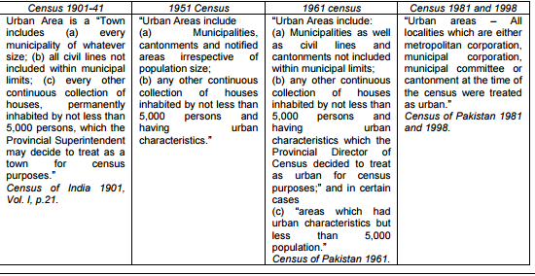
Urban area definition in Pakistan

Slide 10
Urban area definition in Pakistan
In the meantime, a functional definition of urban areas was adopted in the country and was used in the population census of 1972, which considered," an urban area as a concentration of population of at least 5000 persons in continuous collection of houses where the community sense is well developed and the community maintains public utilities such as roads, street lighting, water supply, sanitary arrangements etc. These places are generally with a population substantially non-agricultural or having non-agricultural labor concentration and a high literacy rate”.

Slide 11
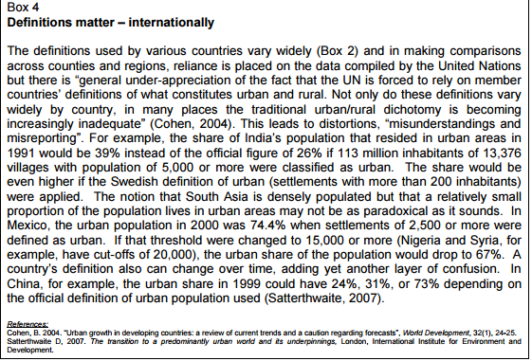
Urban area definition in Pakistan

Slide 12
Rural Areas Characteristics
Rural areas are characterized with having small, tight-knit communities. Ever seen those shows, where everyone knows everyone else, well that’s a rural community. Villages or small towns are considered to be rural areas.
People know each other and are neighbors, friends, etc. Rural areas are classified according their small population and having farming abilities.
Many people in rural areas are considered to be farmers. Rural areas are more dependent on natural resources and organic materials. They have small stores and family run business, compared to the big supermarkets in urban areas.

Slide 13
Rural Areas Characteristics
Many governments have also taken an active part in trying to further urbanize more rural areas and provide extra help in forms of technology, medical and other resources.
Rural areas are more community based people and depend on social gatherings and other similar events. Rural places also have pollution due to lack of large factories.

Slide 14
Differences between rural and urban societies
Rural | Urban
Life in the society is very simple and reflected in the way of living, dressing, food habits, shelter and manners etc. | Life in the city is not simple but very complex and complicated.
The people in the society had homogeneity and thus enjoyed more or less the same social status. | The people in the city belong to different castes, creeds, religions and cultures, thus do not enjoy the same social status
In the rural society there is very little scope for occupational mobility. | In cities there are many occupations, so occupational mobility is as well as frequent.
Here the family played a very significant and predominant role. Its hold was very strong. | In the cities hold of families is not strong, and many functions which the families used to perform have been taken away by other institutions and associations.

Slide 15
Differences between rural and urban societies
Rural | Urban
In villages there is no fast change and as such no necessity for social adaptability. | In the cities there must be fast mobility and adaptability to suit ever changing fast life.
In the rural society culture is very deep-rooted. Everyone loved culture and cultural heritage above everything else. | In the cities it is different to find pure culture.
In a rural society there is no division of labor. | In an urban community there is always division of labor and specialization in job allotment.

Slide 16
Differences between rural and urban societies
Rural | Urban
In this society people loved nature and natural bounties. They were religious minded and afraid of gods and goddesses. | In cities, people have no time to stand and gaze at the nature. They are not religious minded but more materialistic.
There are very few chances of providing employment and incentives to the unemployed by the society. | The cities provide both incentive and employment to the people and thus frustrated villages find solace in the cities which respects ability and judges their worth.

